Slide 1

Maa Manikeshwari University at a Glance

Slide 2
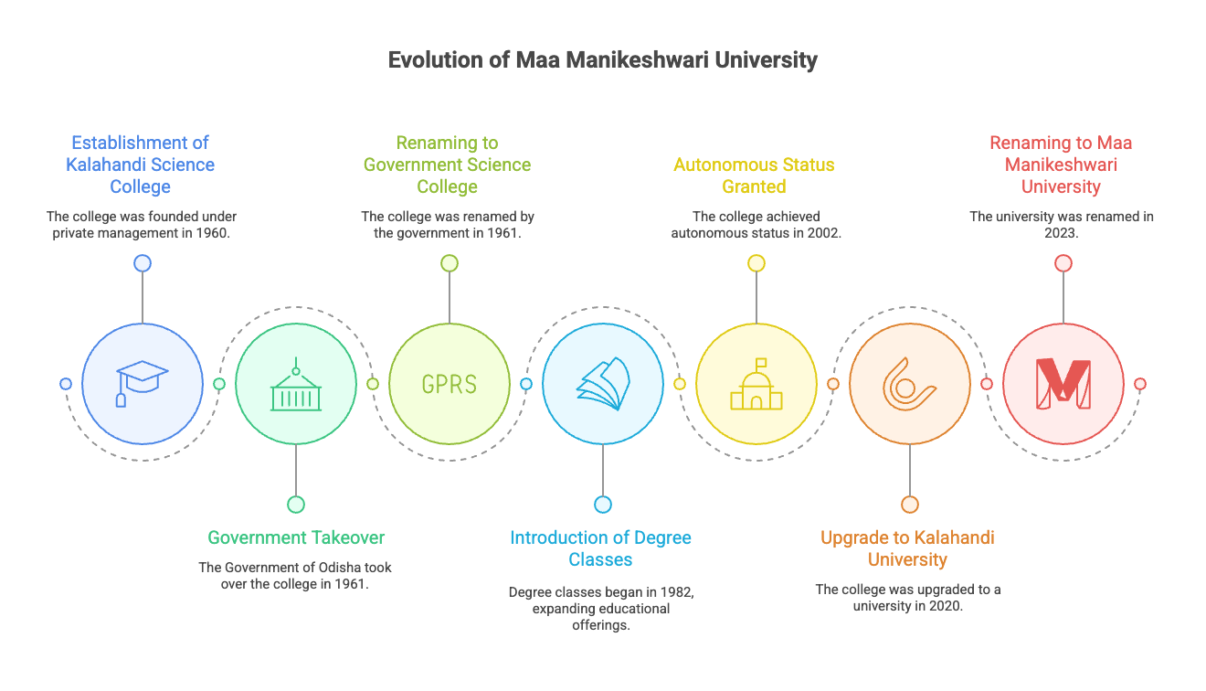

Slide 3


Slide 4


Slide 5
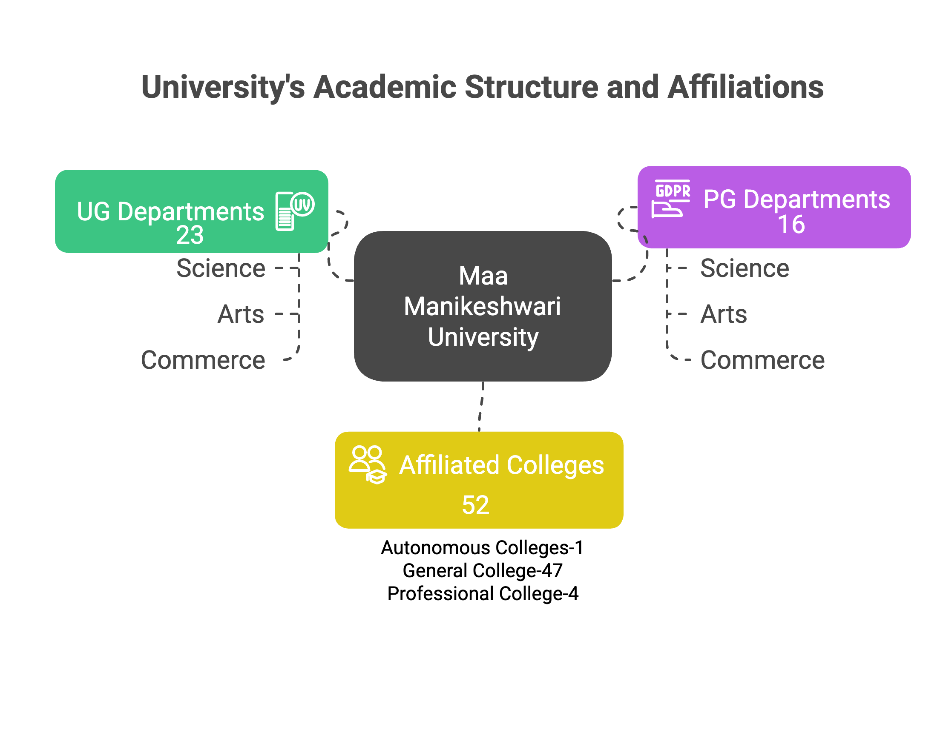
Khariar Autonomous College
Bidyan College, Tujung
Lokadrusthi College of Advanced Technology, Khariar
Mahamaya School of Business management, Nuapada
Saraswati Institute of IT and Management, Bhawanipatna

Slide 6
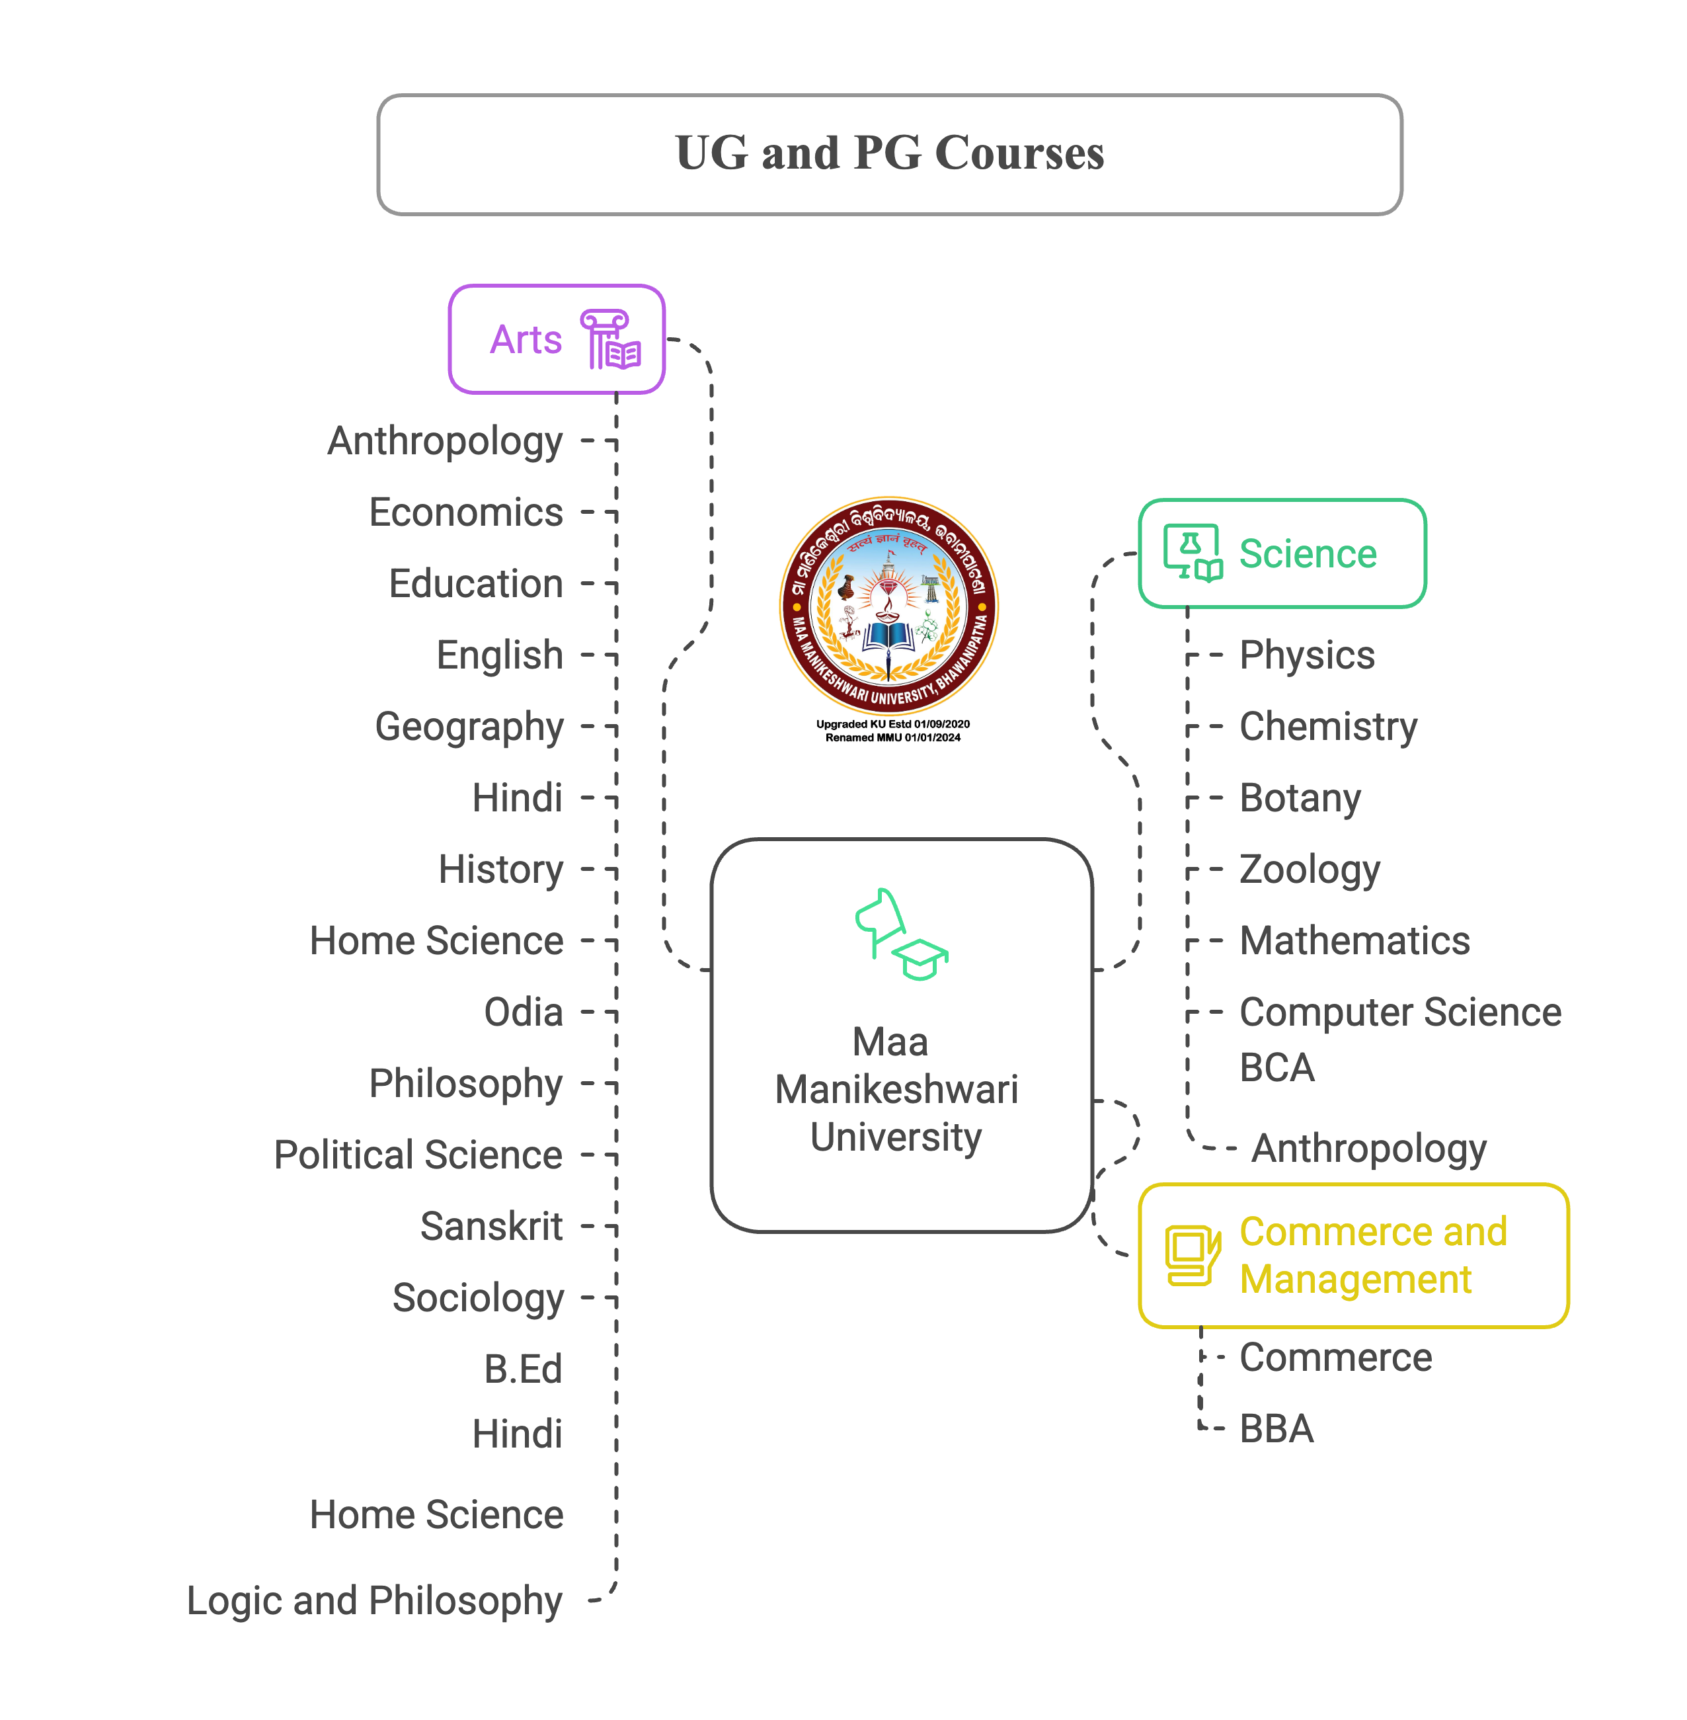

Slide 7
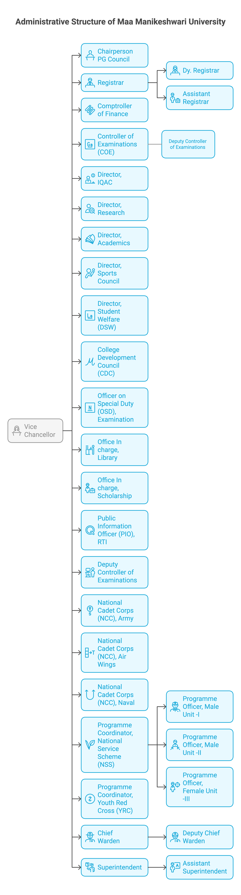

Slide 8


Slide 9
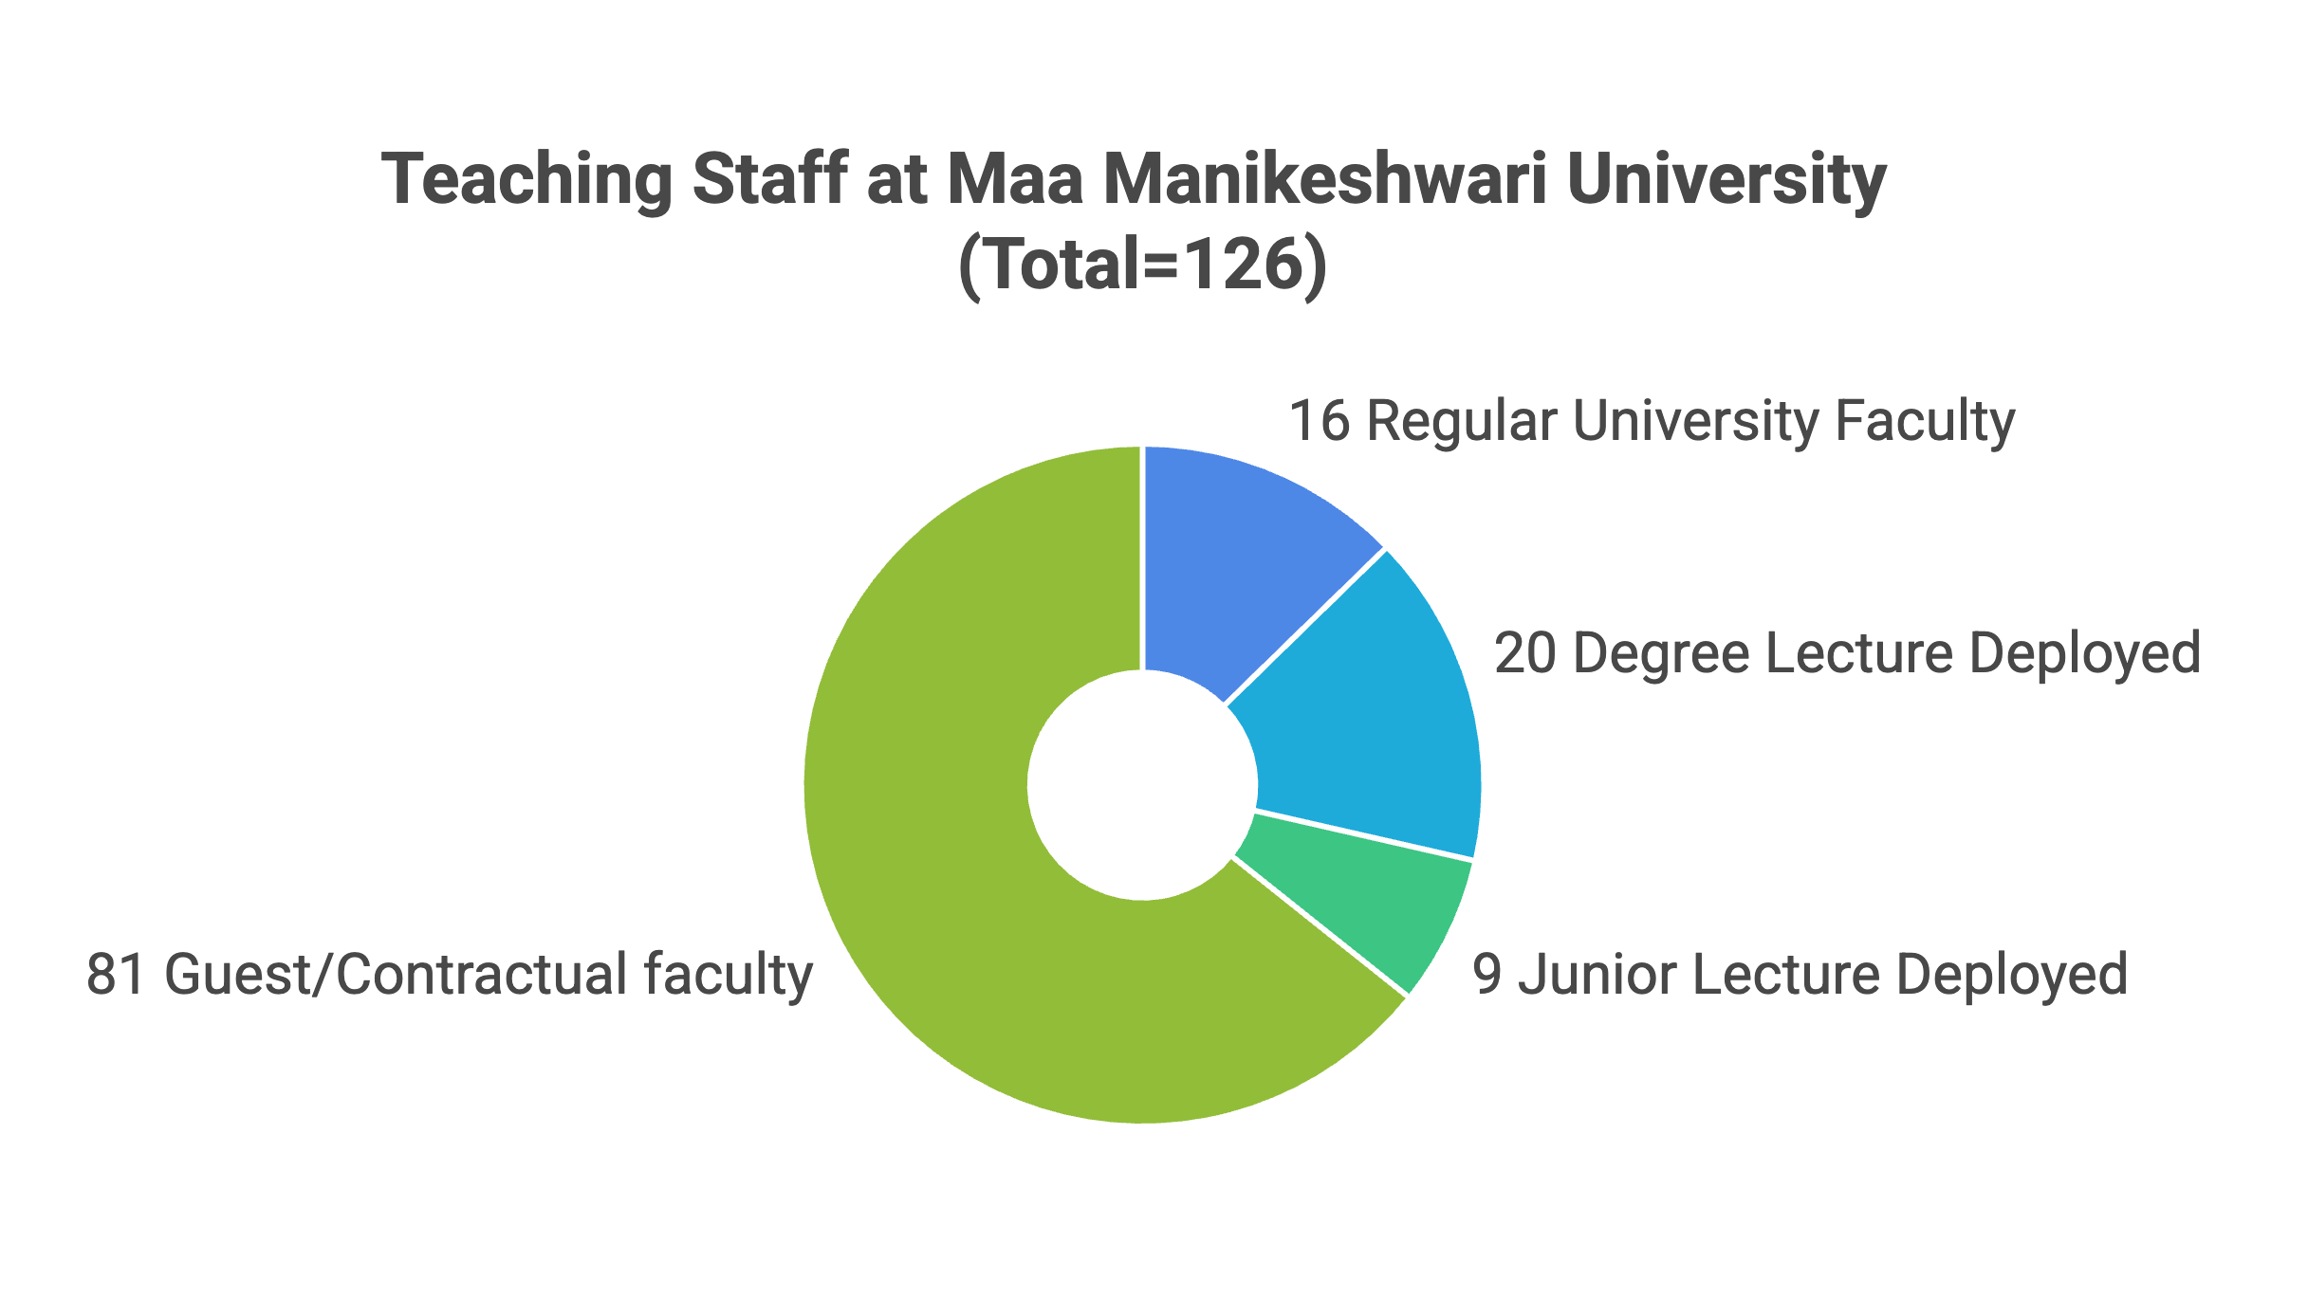

Slide 10
Non-teaching Staff
Non-Teaching Staff | No
Asst. Electrician | 1
Attendant | 44
Computer Assistant | 19
Computer Programmer | 1
DEO | 2
Electrician | 1
Lab. Assistant | 1
Lab. Attandant | 2
Mechanic | 1
Retd. Attandant | 1
Retd. Head Clerk | 1
Retd. Senior Asst. | 1
Senior Assistant | 1
Store Keeper | 1
Sweeper | 9
Security Guard | 15
Total | 91

Slide 11
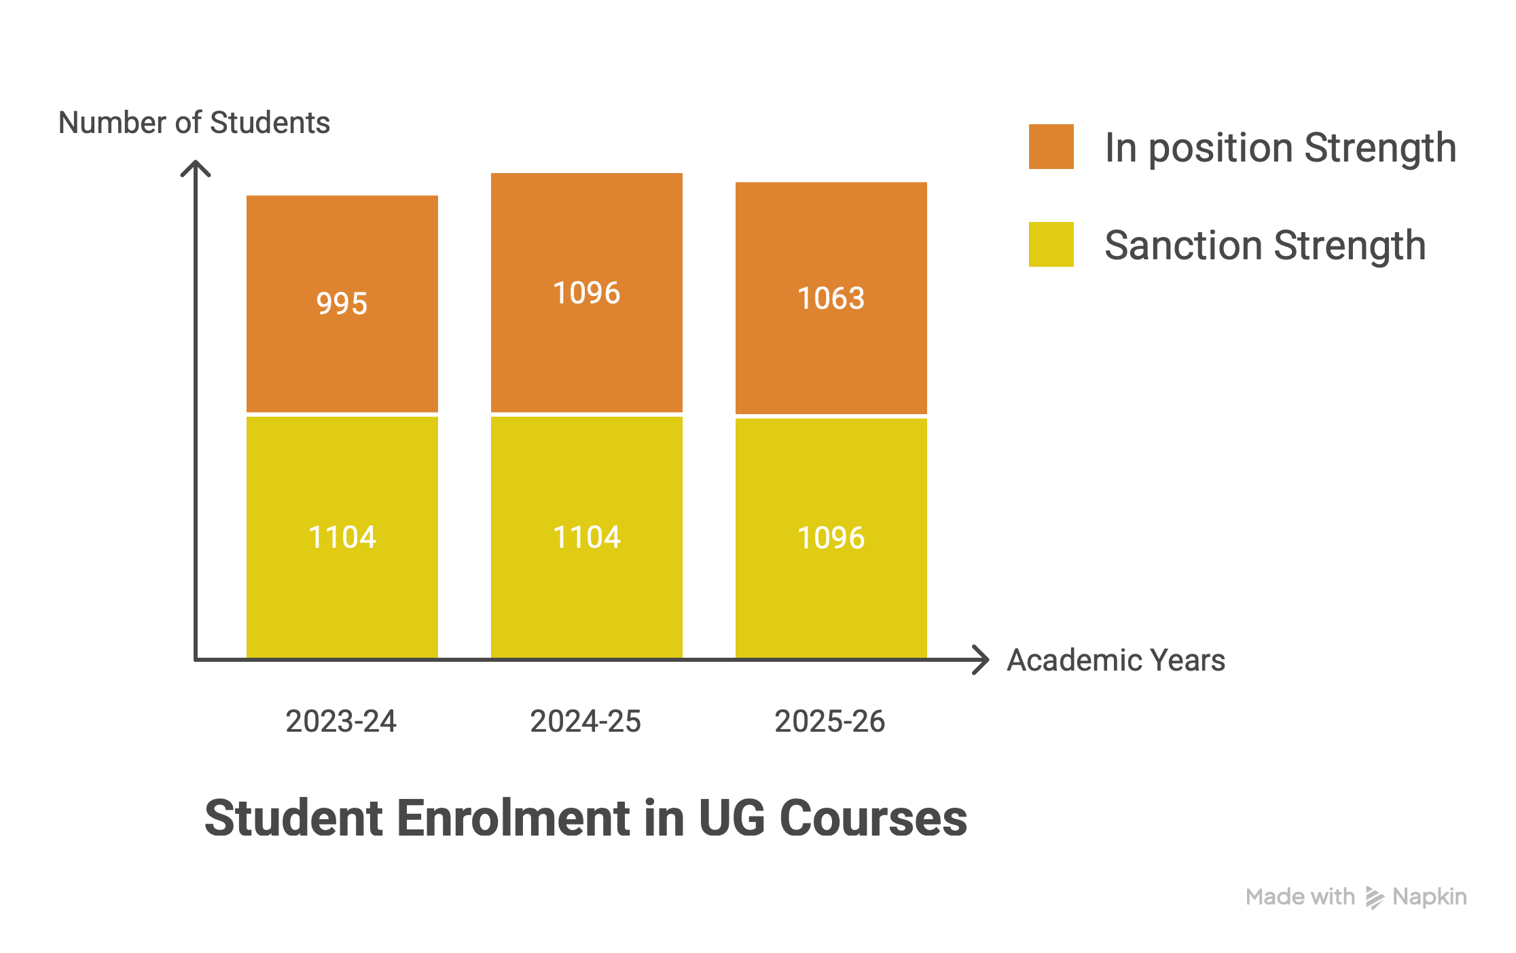

Slide 12
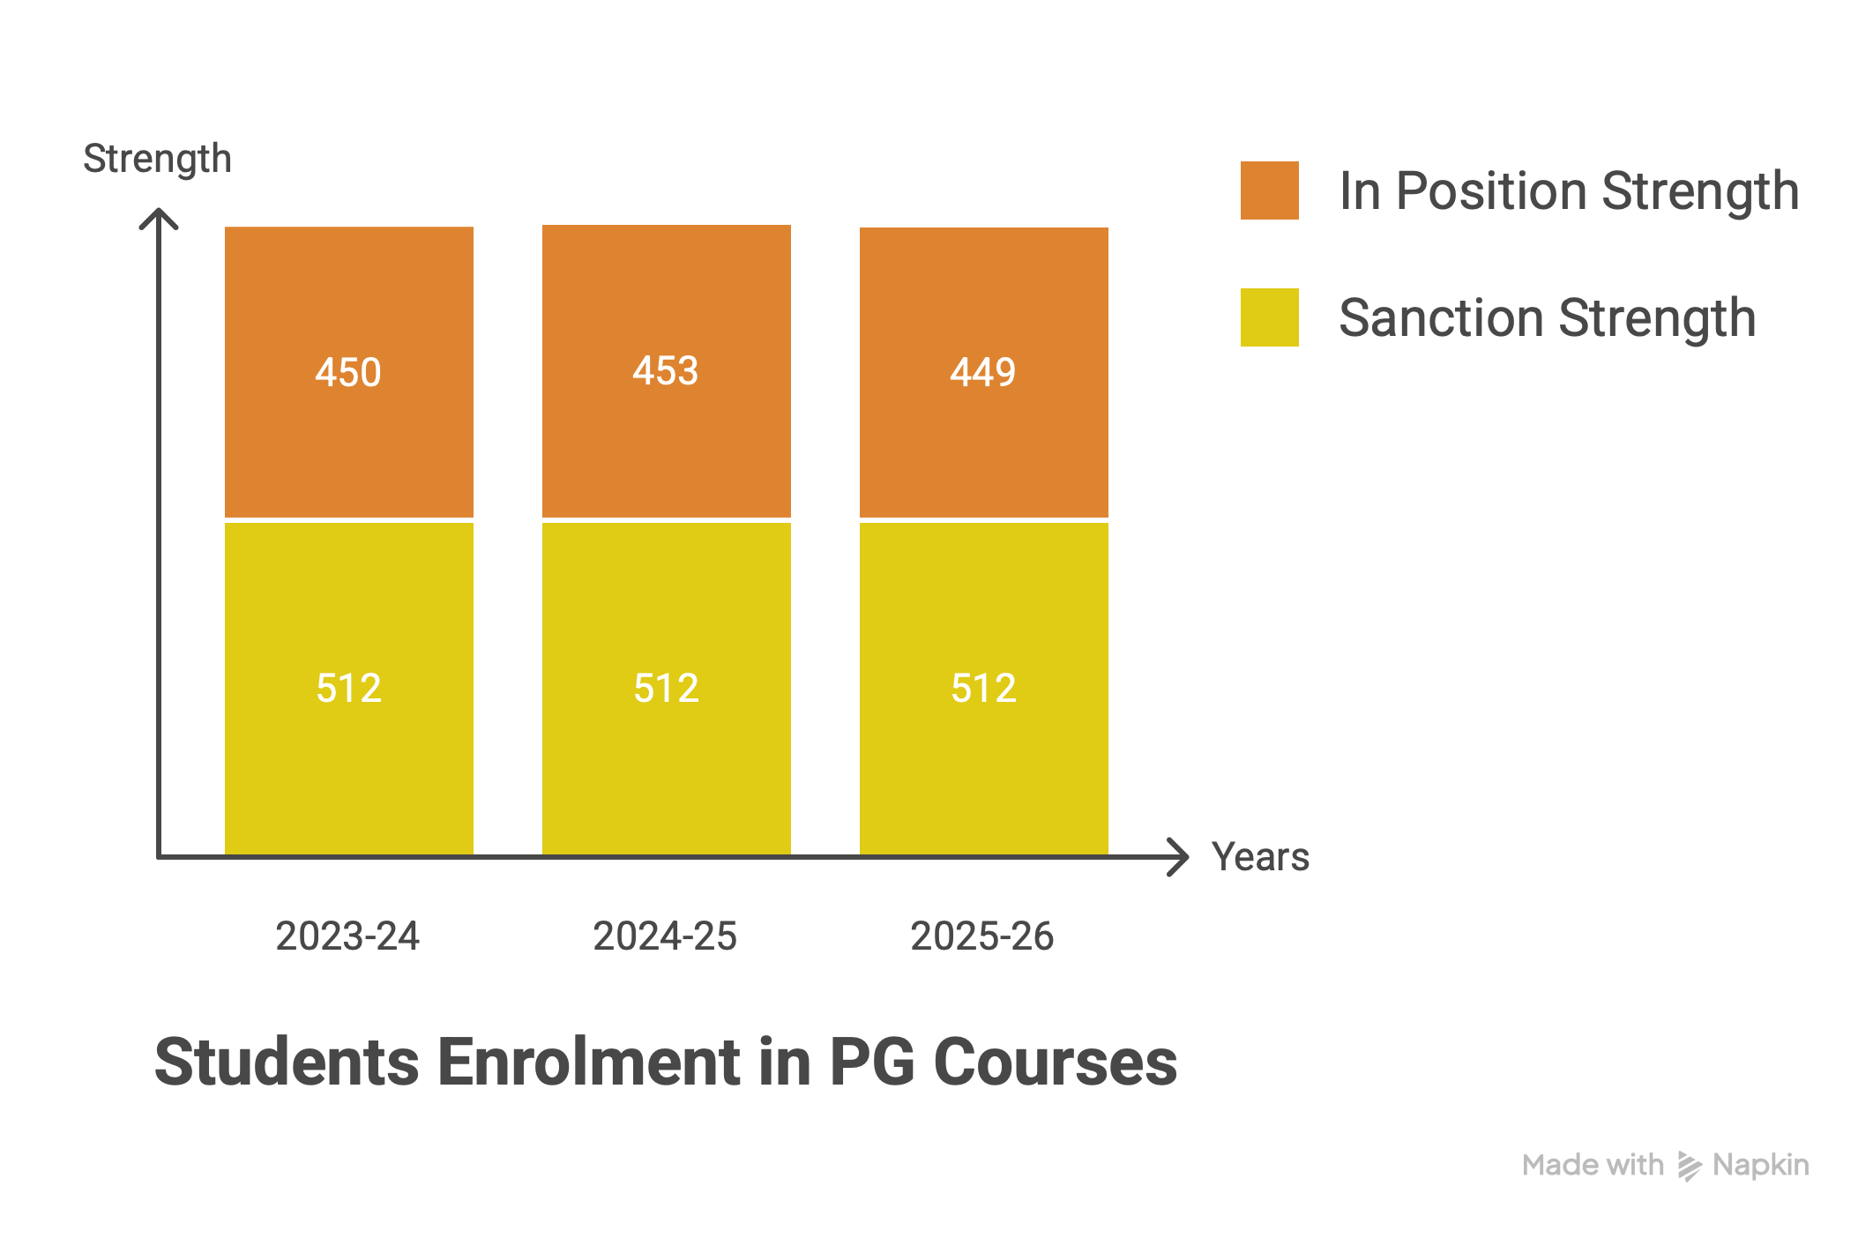

Slide 13
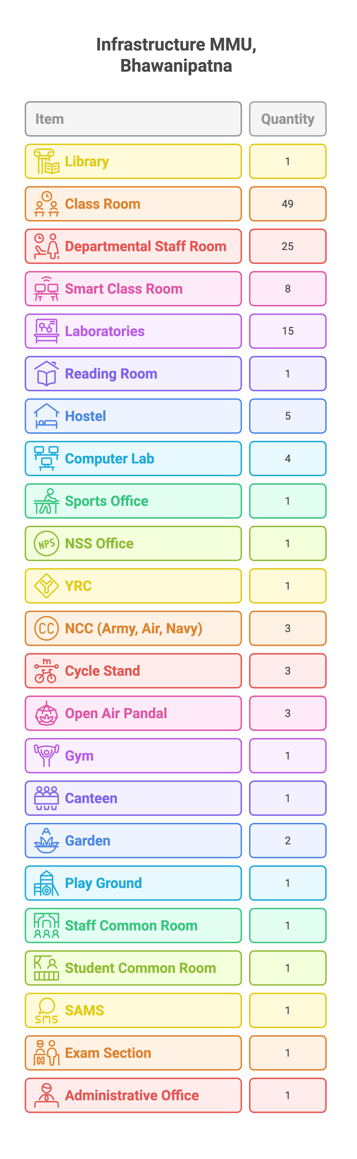

Slide 14


Slide 15
Faculty Corner

Slide 16
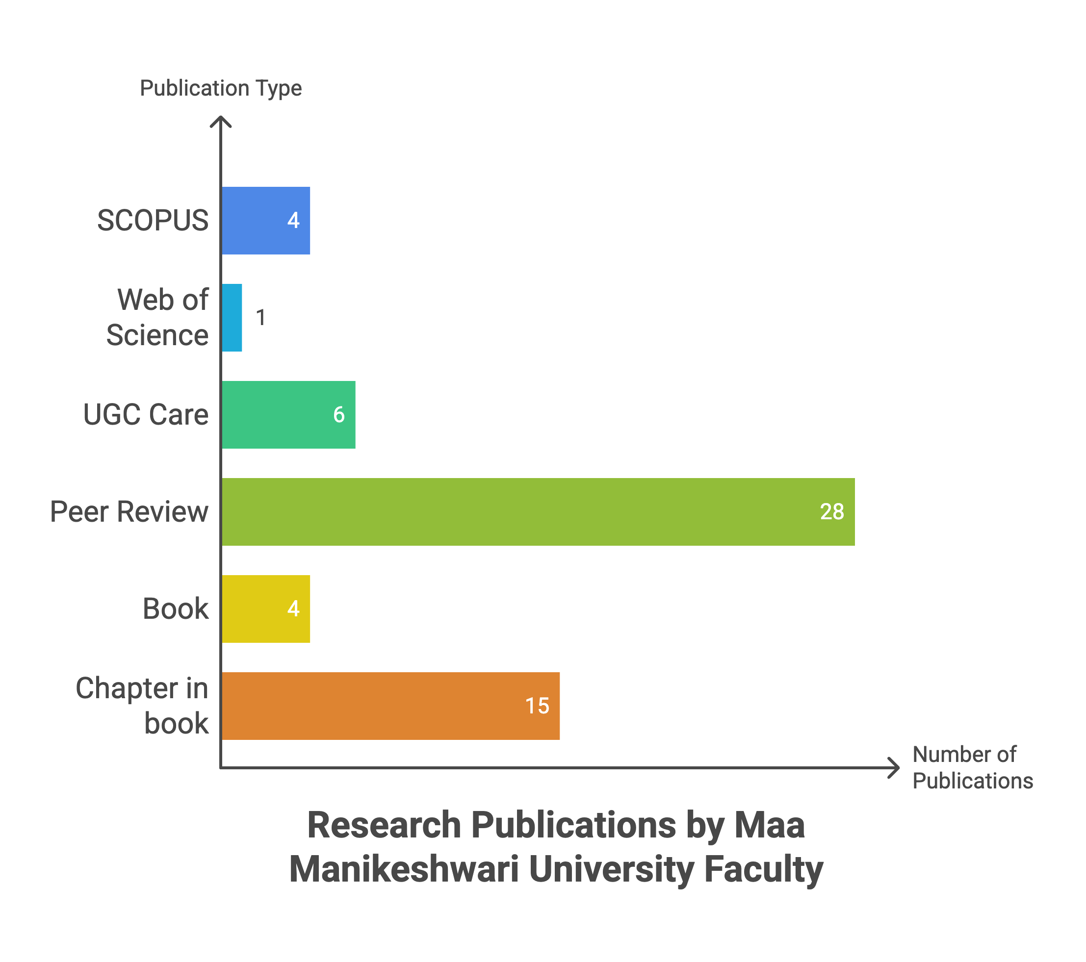

Slide 17
Conference, Seminar, Workshop, Training Program Organized

Slide 18


Slide 19


Slide 20
Other Program Organized by the University

Slide 21
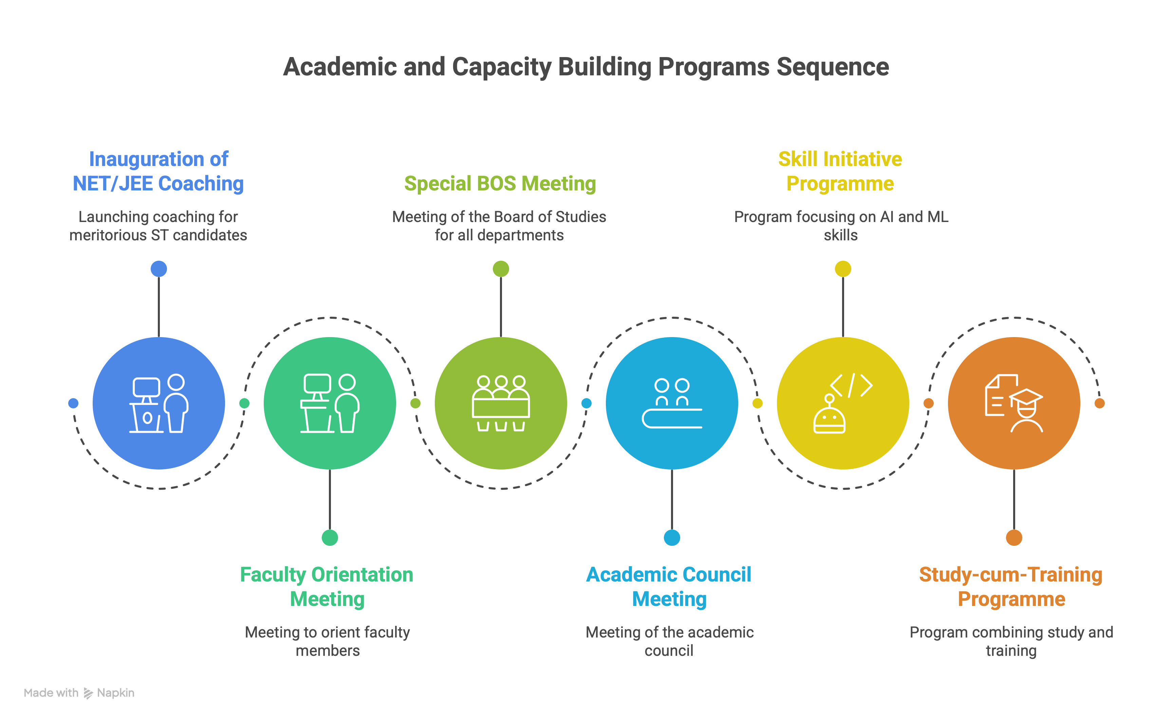

Slide 22


Slide 23
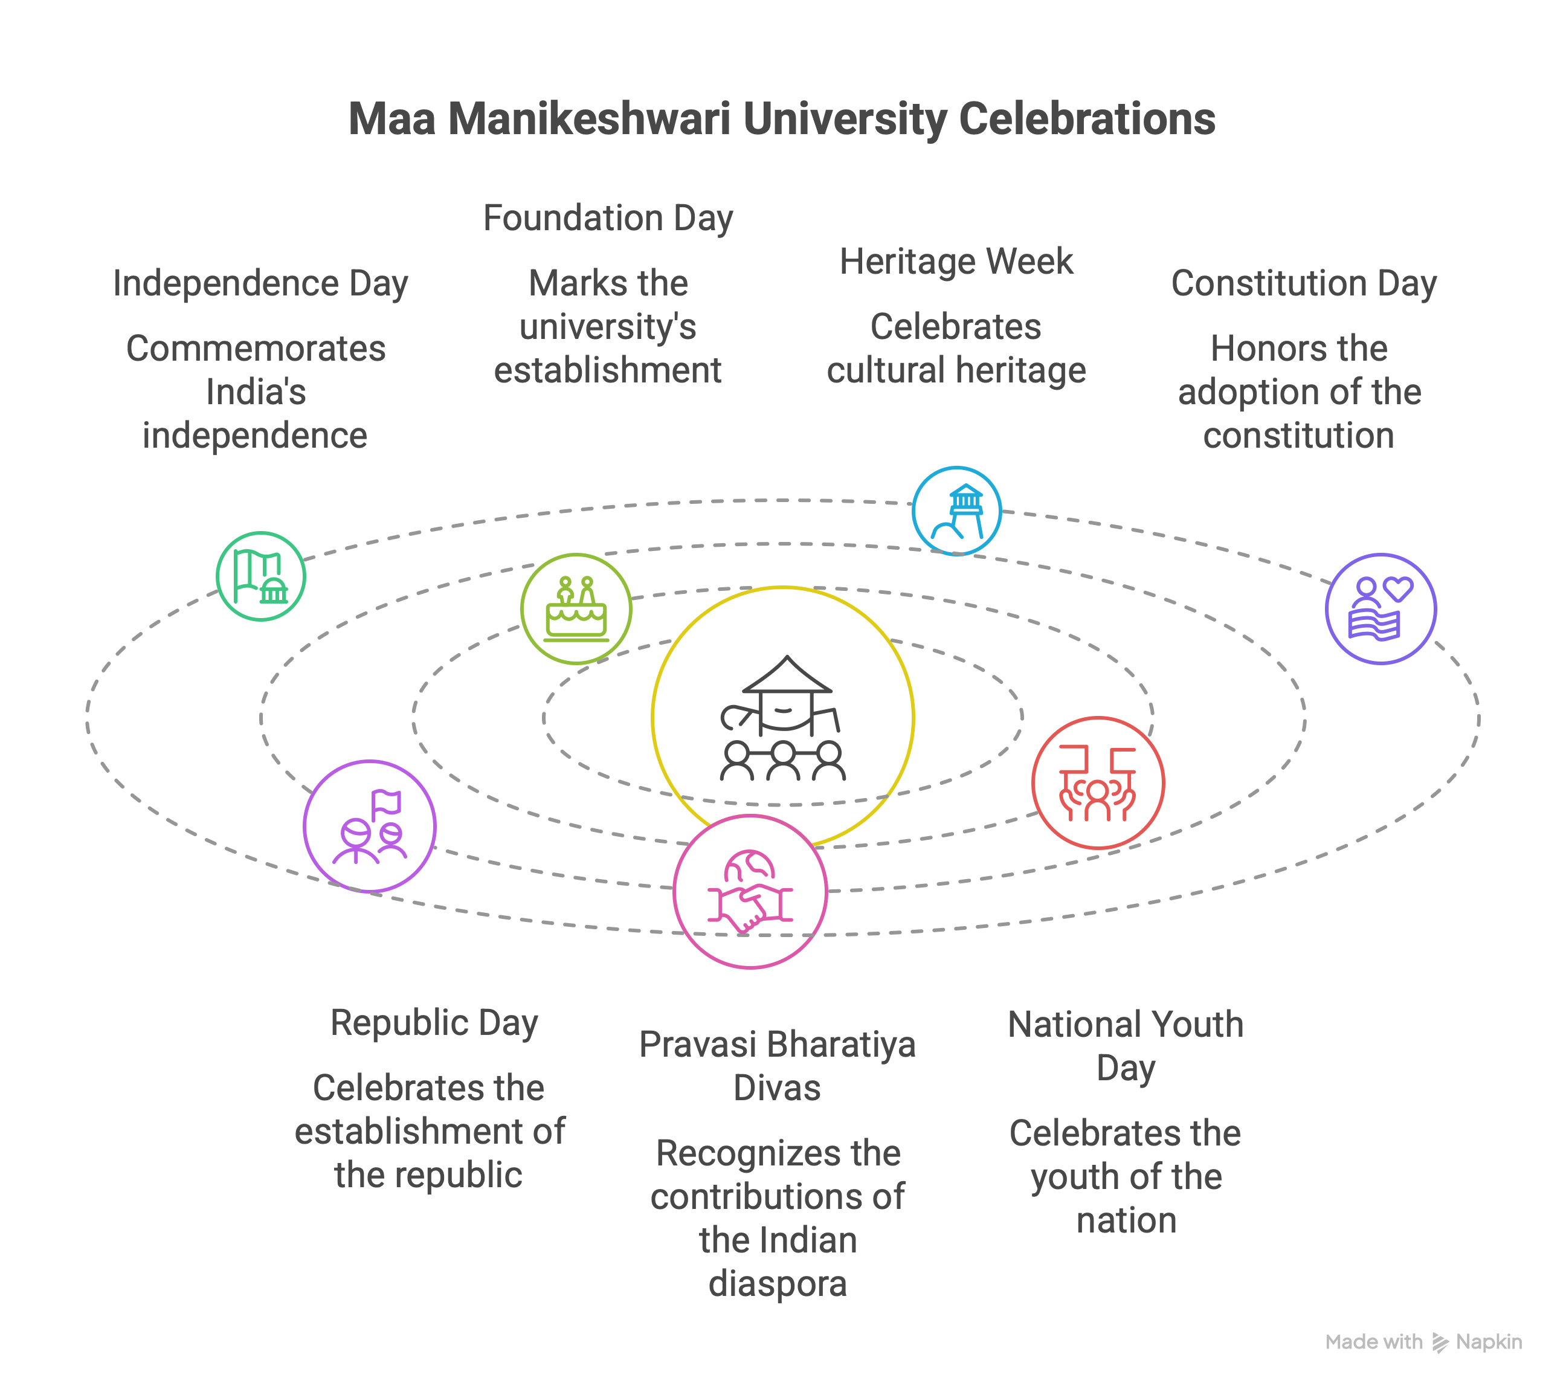

Slide 24


Slide 25
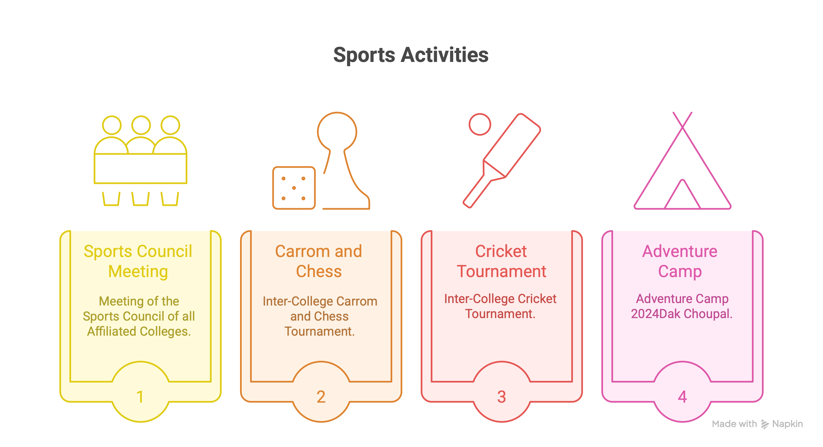

Slide 26
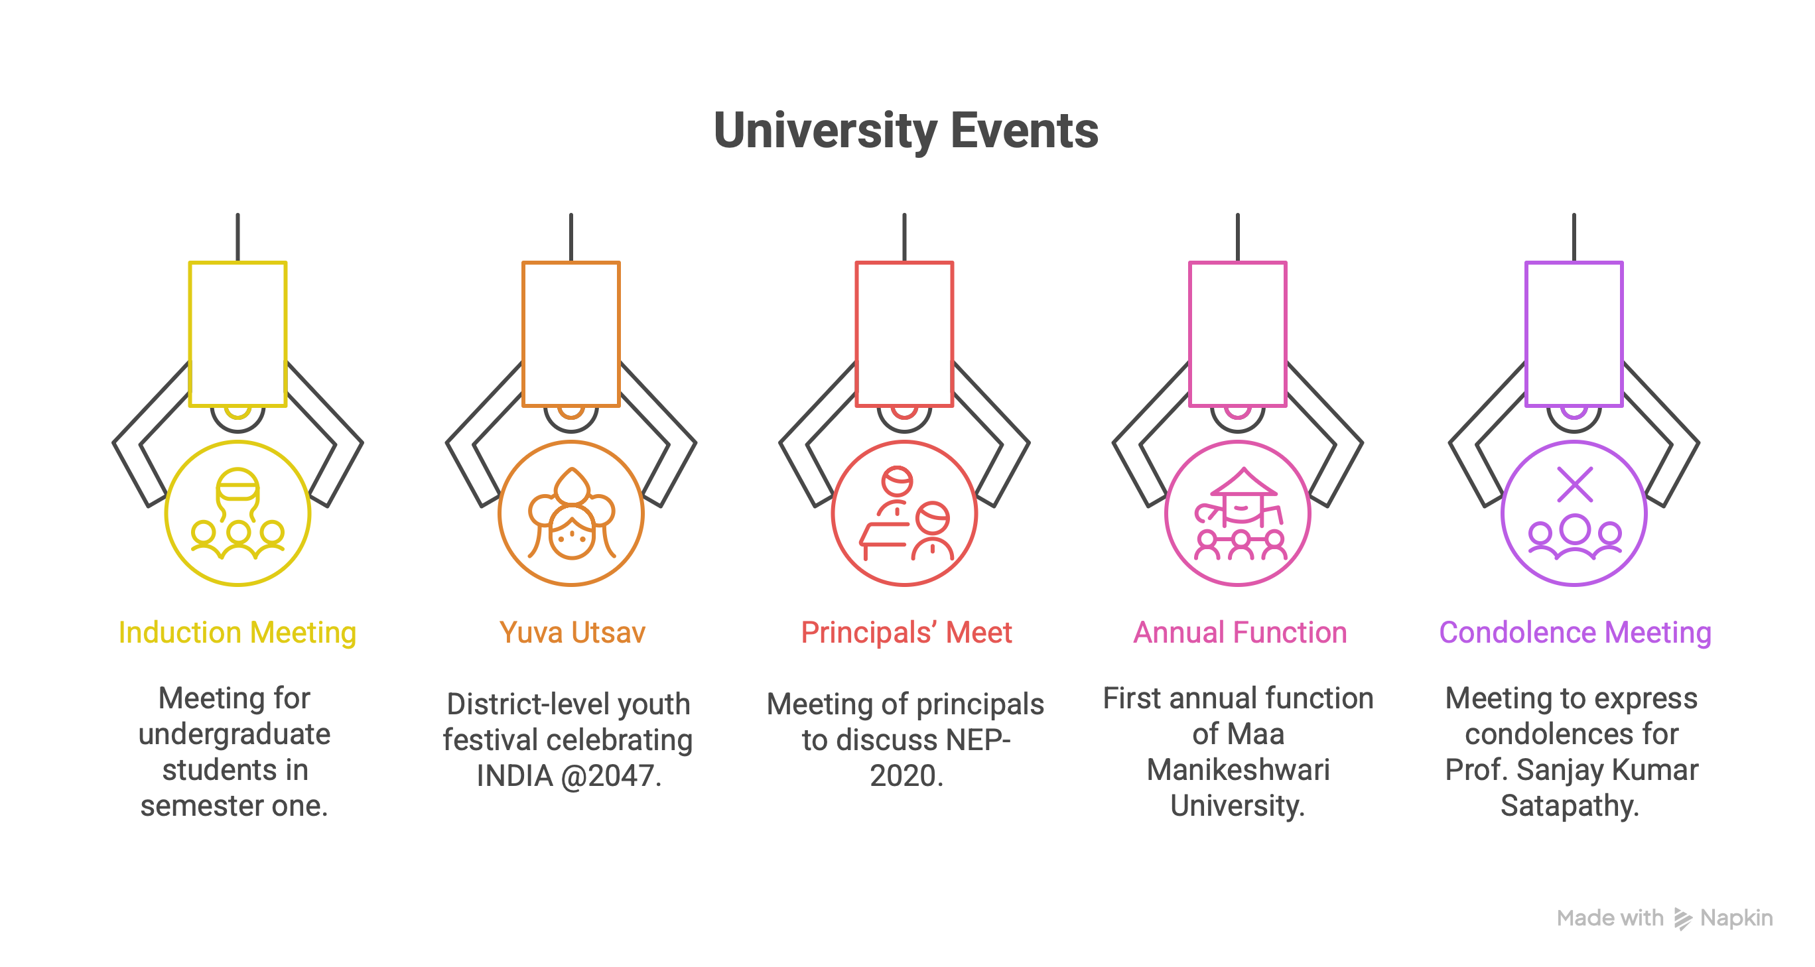

Slide 27
Student’s Corner

Slide 28


Slide 29
Achievement of the Students (UGC/CSIR-NET & JRF)
1 | Anthropology | Sthitiprajna Swain | Qualified Only Ph.D.
2 | Commerce | Nabanita Sahu | Assistant Professor & Ph.D.
3 | Education | Smrutiranjan Sahoo | Assistant Professor & Ph.D.
4 | Odia | Krupasindhu Behera | Assistant Professor & Ph.D.
5 | Odia | Bhaktilata Sahu | Assistant Professor & Ph.D.
6 | Political Science | Laxmi Suna | Assistant Professor & Ph.D.
7 | Political Science | Gupteswar Sahu | Assistant Professor & Ph.D.
8 | Political Science | Indira Charan Bodek | Assistant Professor & Ph.D.
9 | English | Shankar Meher | NET
10 | English | Naresh Suna | NET
11 | English | Pallavi Rout | JRF
12 | Odia | Sumanta Rana | JRF
13 | Odia | Ashirbada Sahoo | JRF
14 | Geography | Rabi Narayana Majhi | Qualified Only Ph.D.

Slide 30
15 | Education | Swapna Goud | Qualified only for PhD
16 | Education | Shradhanjali Gahir | Qualified only for PhD
17 | Geography | Romiya Bhoi | Assistant Professor and PhD
18 | Odia | Jasobanta Sahu | Qualified only for PhD
19 | Odia | Priyanka Kandher | Assistant Professor and PhD
20 | Odia | Chuleshwari Kata | Qualified for NET, JRF and PHD
21 | Political Science | Akankshya Das | Qualified only for PhD
22 | Political Science | Chetaswani Sahu | Qualified only for PhD
23 | Political Science | Shritam Tripathy | Qualified only for PhD
24 | Political Science | Basamati Patra | Assistant Professor and PhD

Slide 31
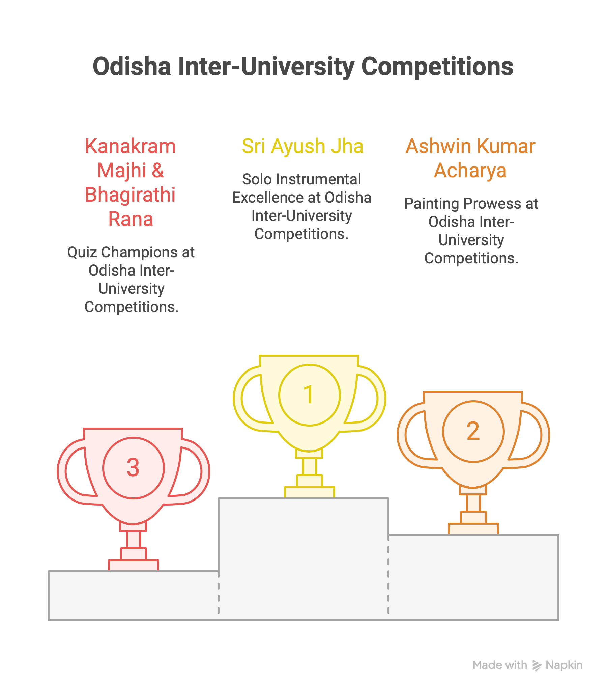

Slide 32
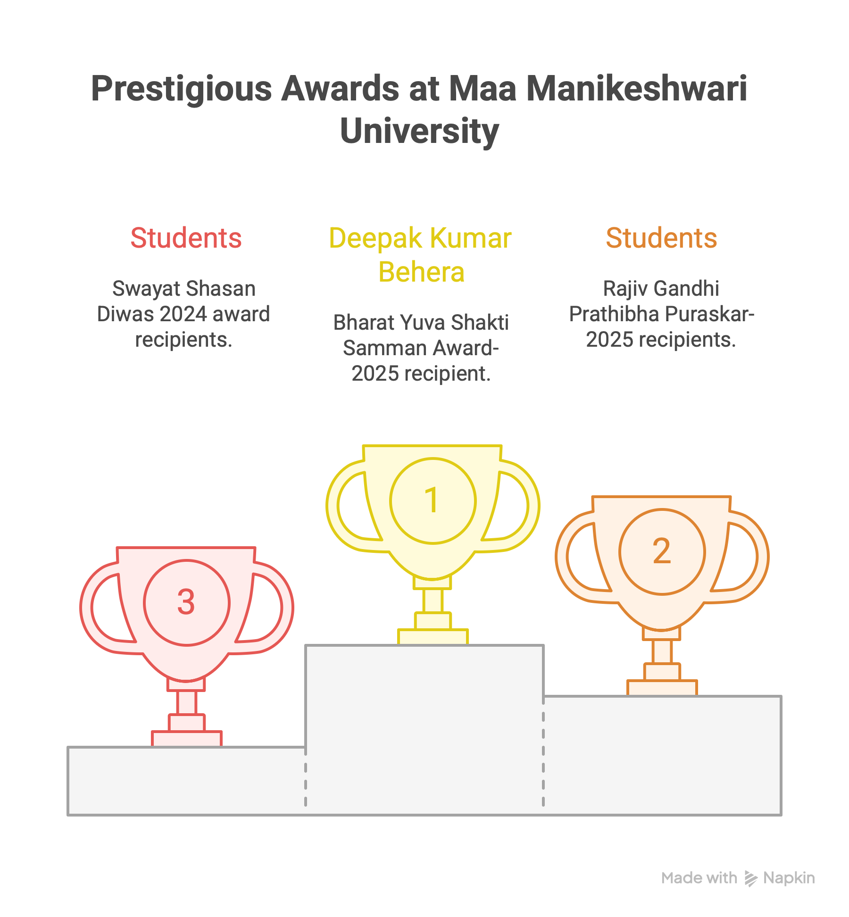

Slide 33


Slide 34
Thank you

